Slide 1

ScaleFit

Slide 2
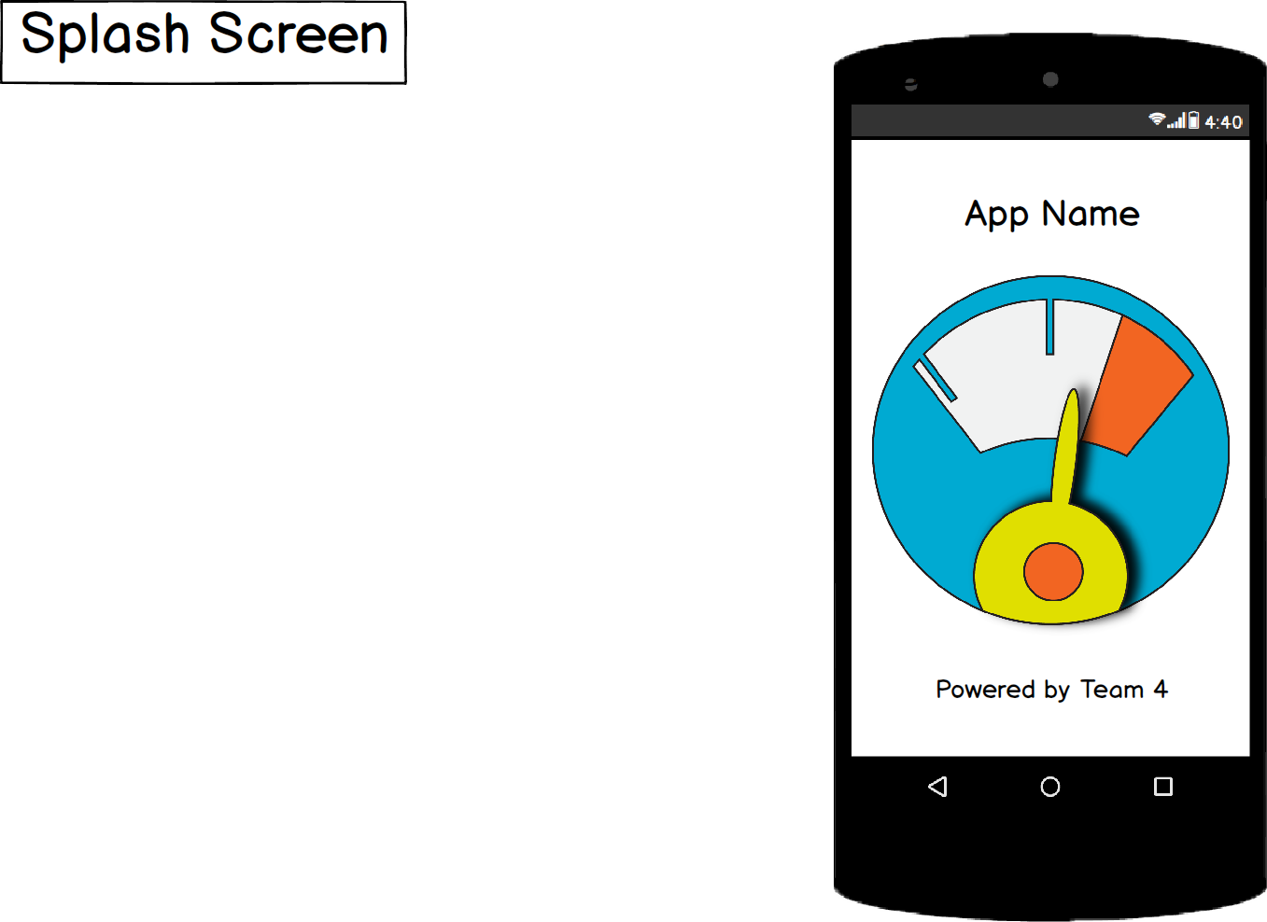
Splash Screen

Slide 3
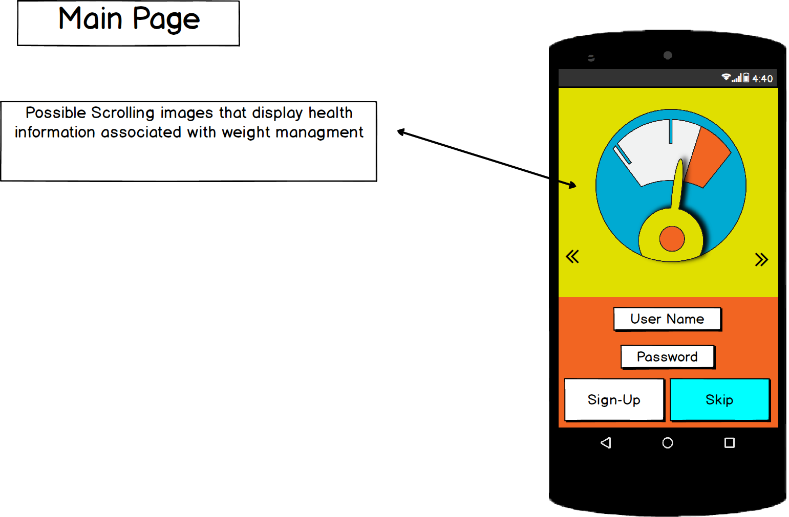
Initial Login Page

Slide 4
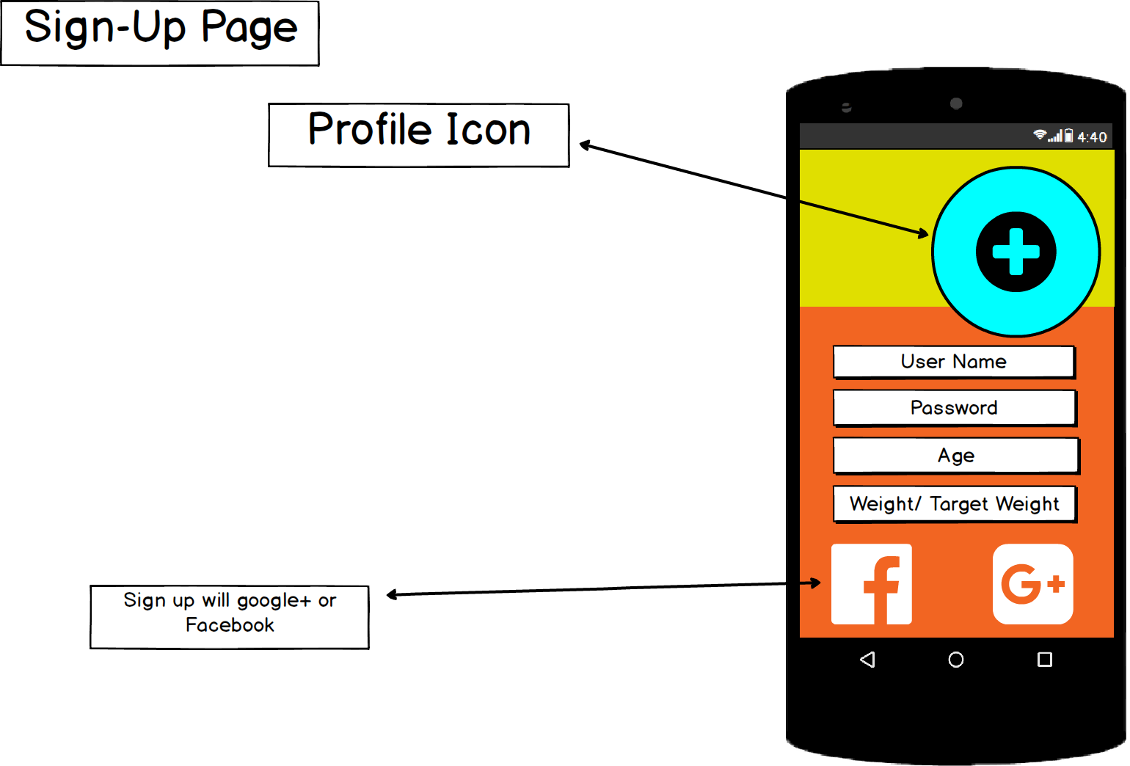
Initial Setup Screen

Slide 5
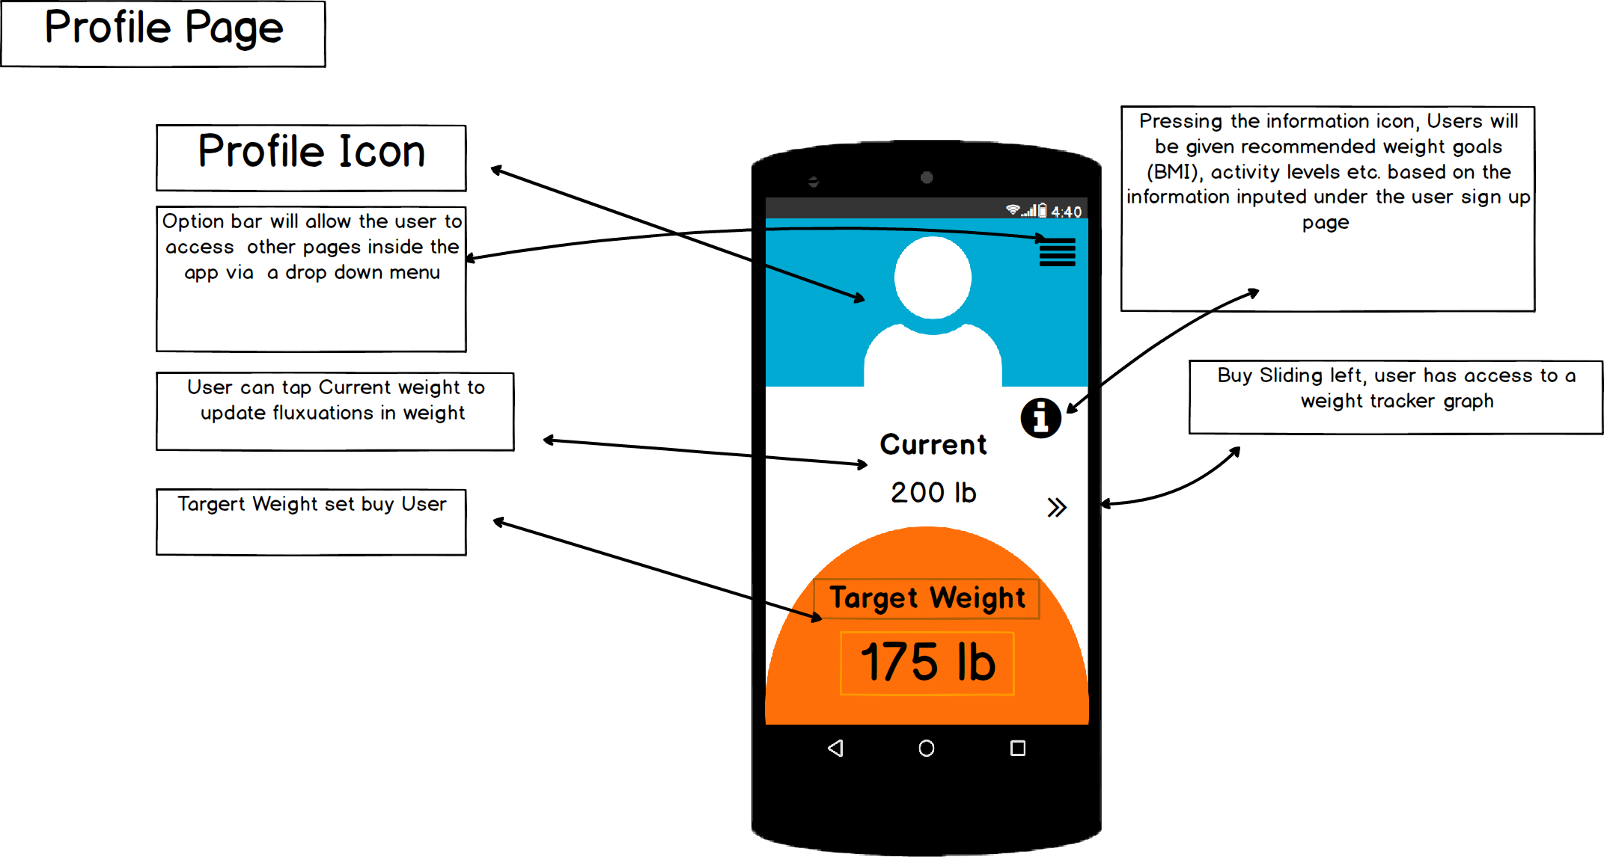
Main Profile Page

Slide 6
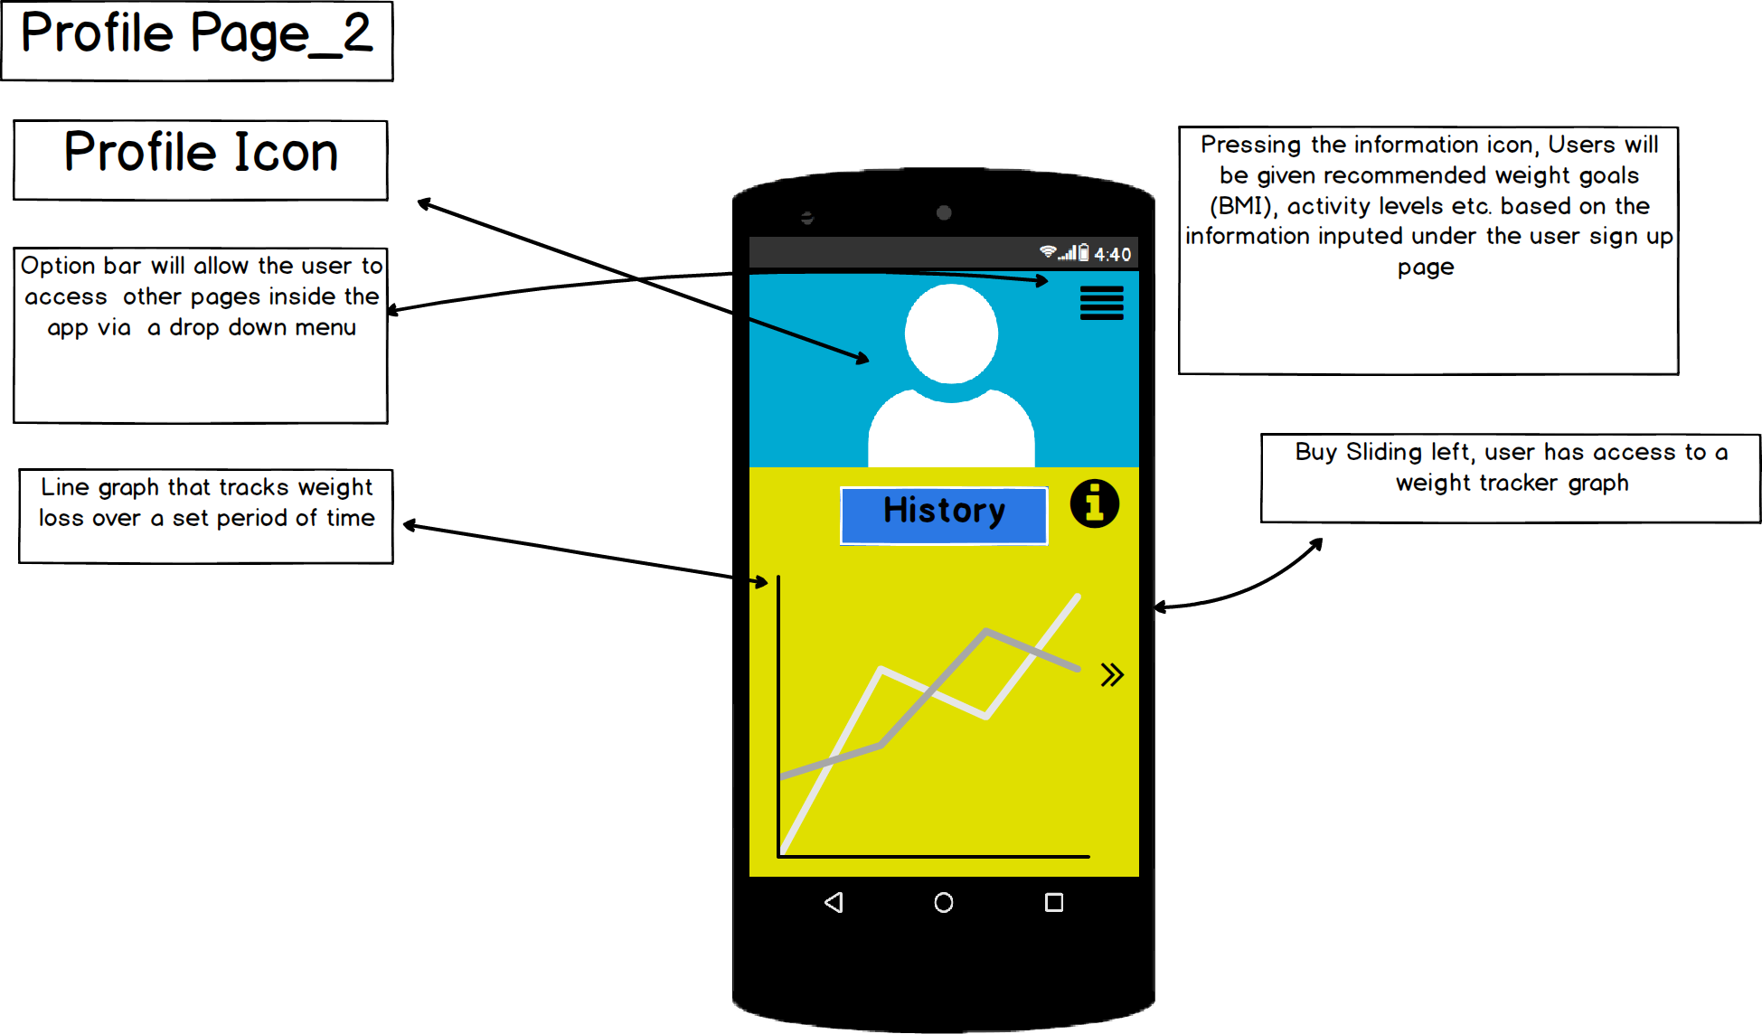
Data Page
Graph Showing Average Gains/Losses inside your general demographic from our custom, purpose built database

Slide 7
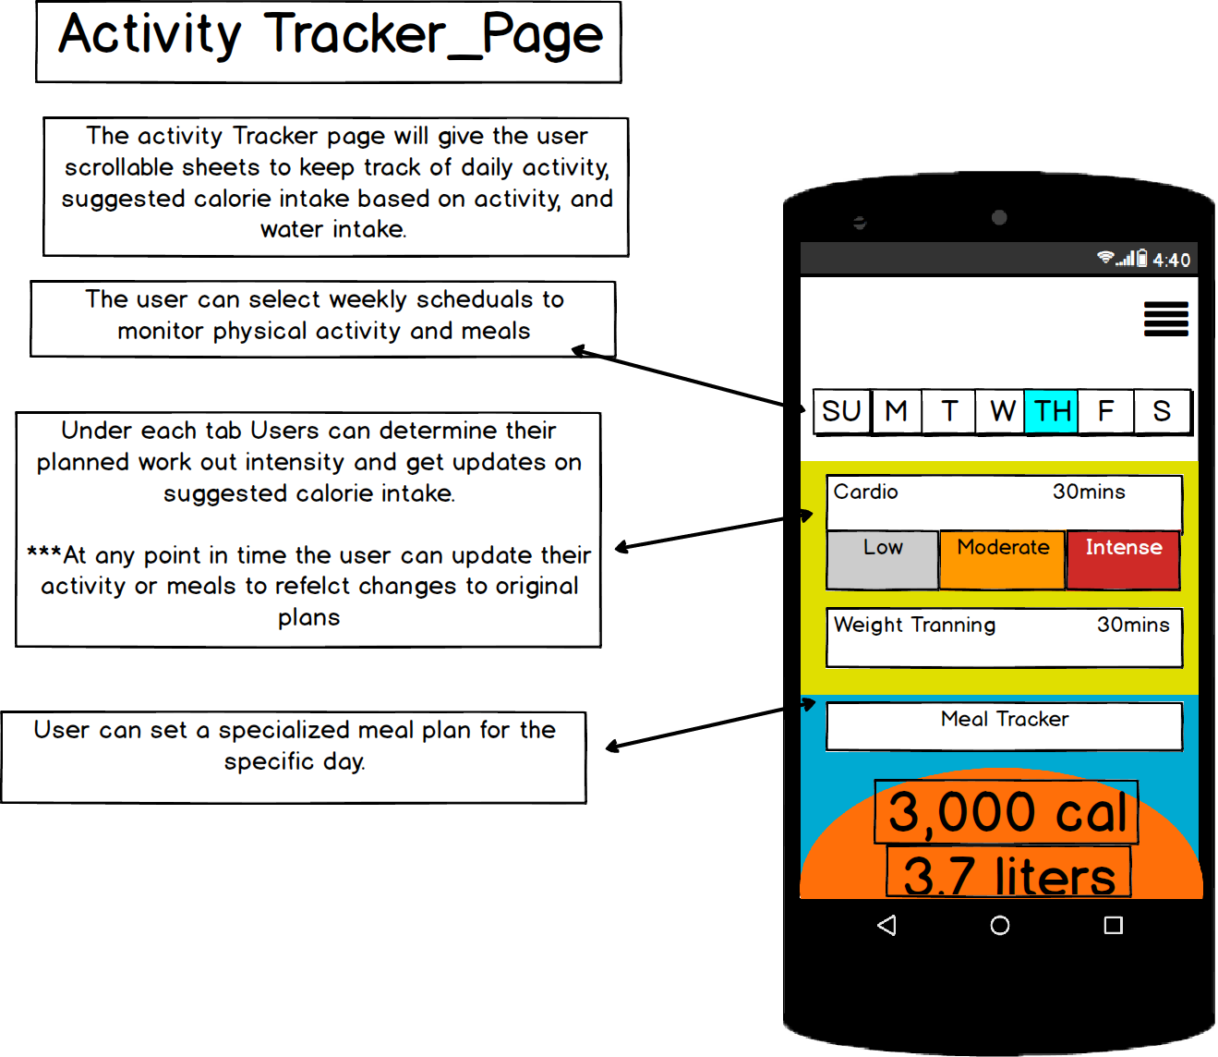
Lifestyle Tracker

Slide 8
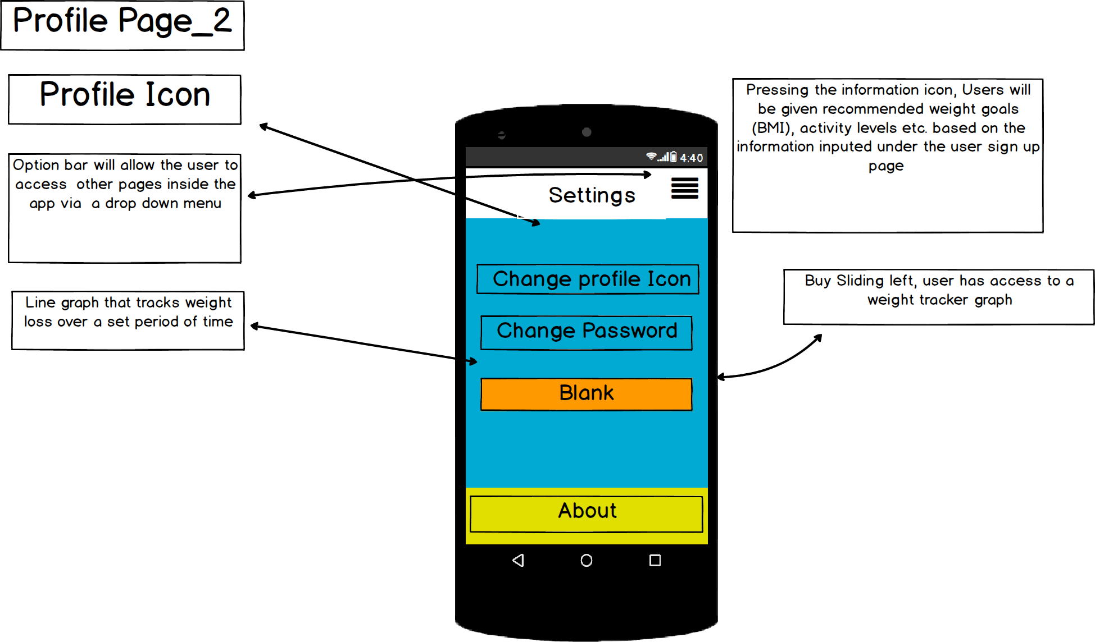
Settings Page

